Slide 1
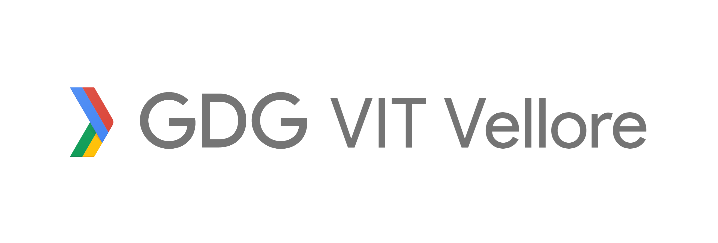
SubConn
Subsidy Connections

Slide 2
Team GDG-VIT
Members
Apurva Nitanjay
Nishant Rodrigues
Surya K
Vineeth S

Slide 3
1.
PROBLEM STATEMENT
Let’s start by explaining the problem we are trying to solve.

Slide 4
Problem Statement
The government spends Rs. 750 billion ($13.6 billion) per year on the Public Distribution System (PDS).
With the total subsidies provided added up to a staggering Rs. 2400 billion.

Slide 5
Problem Statement Contd.
These services do not reach the targeted people due to corruption in the system.
This is clearly visible by the fact that 21% of the population still remain undernourished.

Slide 6
2.
SOLUTION
Our solution!

Slide 7
Solution
Tracking the products from the supplier to the consumer through the chain.
Emiminate tampering by middlemen.
Maintain quality control of the goods.

Slide 8
You must be the change you wish to see in the world.
- Mahatma Gandhi

Slide 9
3.
METHODS APPLIED
A method to the madness.

Slide 10
Expected output
Reduce losses to 10%.
Prevent theft by middlemen.
Good quality produce reaches targeted consumers.

Slide 11
Tools and Platforms
Tagging each item using a QR code.
Development of a Progressive Web Application (PWA).

Slide 12
Tools and Platforms Contd.
Secure and open database using NoSQL and Blockchain to prevent any tampering.
Aadhar API to validate and verify the agents and consumers.

Slide 13
4.
ARCHITECTURE DIAGRAM
A look at the inside.

Slide 14
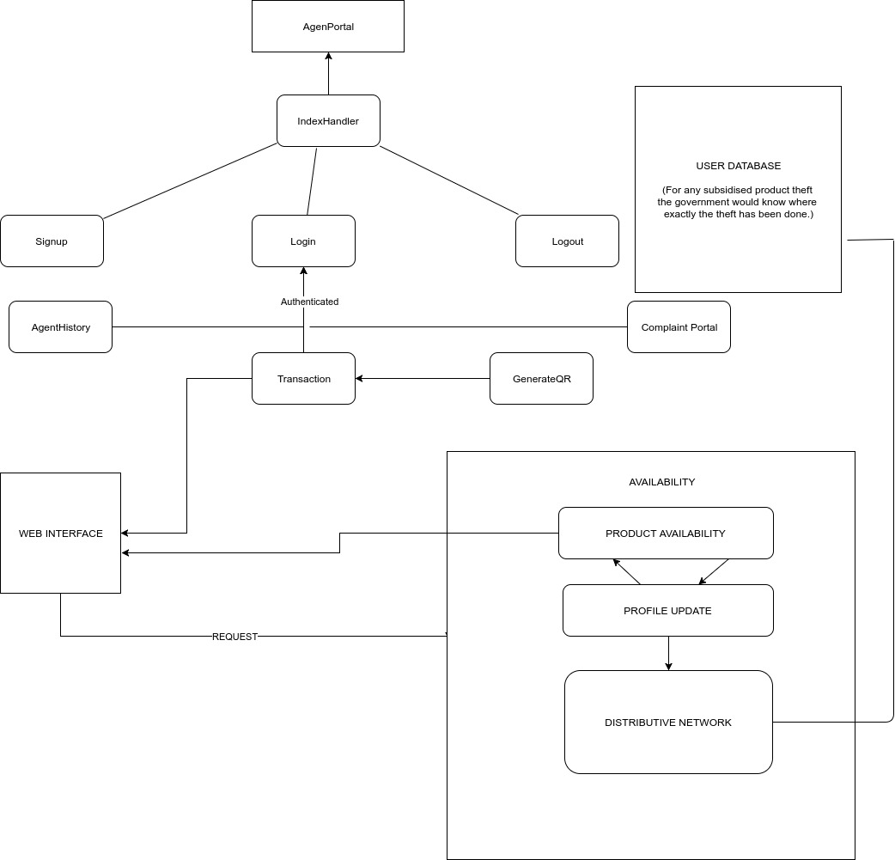
Data Flow Diagram

Slide 15
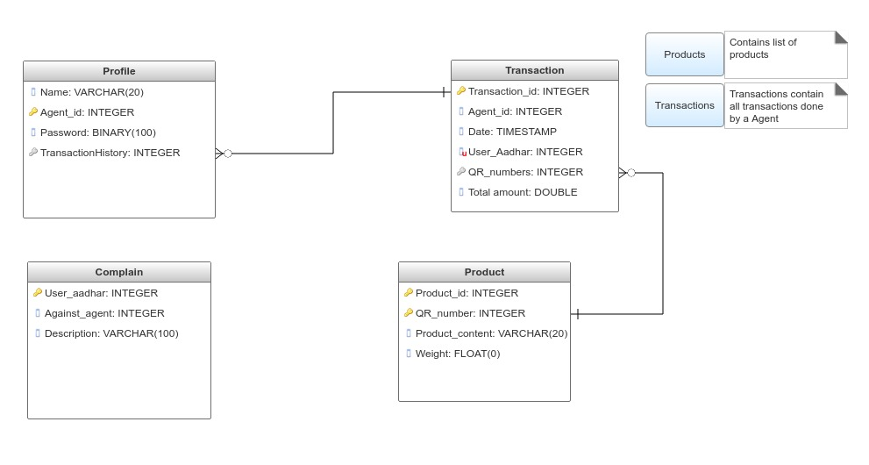
Metadata

Slide 16
5.
WIRE FRAME
Application Layout.

Slide 17
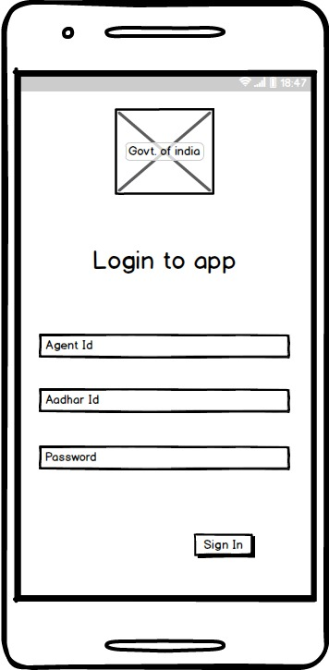
Login

Slide 18
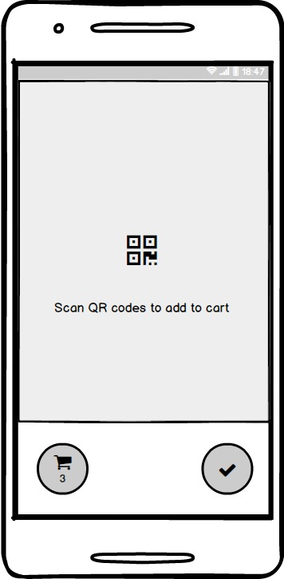
QR Code

Slide 19
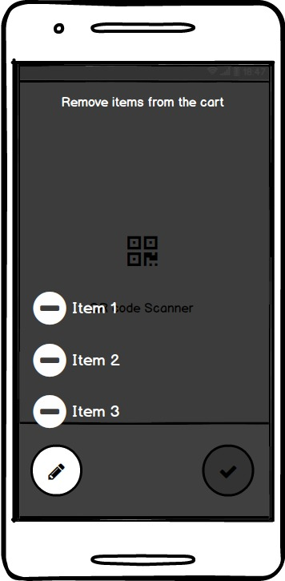
Cart

Slide 20
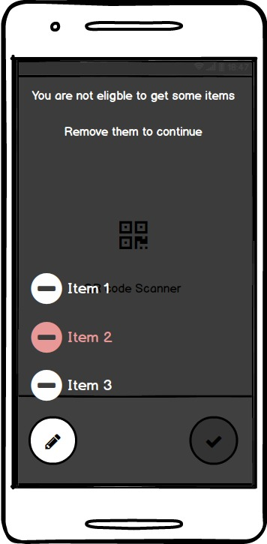
Error Handling

Slide 21
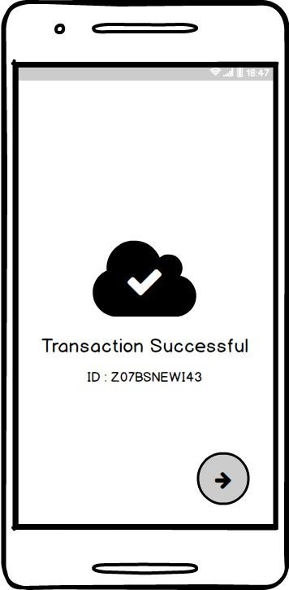
Success Message

Slide 22
6.
Expansion
What can this be transformed into?

Slide 23
Scope for Expansion
Can be easily scaled and applied to various Producer – Consumer chains for management.
Modules are completely flexible for any verification based schemes. Eg. NREGA

Slide 24
THANKS!
Any questions?
You can find me at:
+919945120209
rohan.rodrigues2016@vitstudent.ac.in

